Slide 1
Predicting Customers Likelihood to Churning
Theophilus Ebode

Slide 2
Outline
Objective
Models used
Metrics for evaluating the models
Explanation of model
Findings
Recommendations
Appendix

Slide 3

Objective
To develop a model that predicts the likely customers to churn

Slide 4
Models developed
Model 1 : Random Forest (using 10most important features from the data)
Model 2: Gradient Boosted Decision Tree (using 10 most important features from tha data)
Model 3: Random Forest (using all features from the data)

Slide 5
Metrics for evaluating the model
Recall
Confusion matrix
F1-score
Accuracy
Precision
However, 'Recall' was selected as the most appropriate metric

Slide 6

Recall

Slide 7
Recall...
Recall identifies all the positive instances out of all the actual positive.
In this case, customers who will likely churn instances.
In our data, model 1 correctly identifies 95.5% of customers who will likely churn.

Slide 8

Evaluation of the model
Confusion matrix

Slide 9
Confusion matrix ...
Confusion matrix shows how often our predictions are correct and incorrect predictions. By looking at the numbers in each quadrant, we can calculate different metrics that tell us more about the model's strengths and weaknesses.

Slide 10
Confusion matrix...
True Positive (TP): The model correctly predicted that a customer will repay their loan.
2
False Positive (FP): The model predicted that a customer will repay their loan, but in reality, they did not.
3
True Negative (TN): The model correctly predicted that a customer will not repay their loan.
4
False Negative (FN): The model predicted that a customer will not repay their loan, but in reality, they did.
The confusion matrix is divided into four quadrants, which represent different types of predictions that the model can make:
1

Slide 11

Explanation of the confusion matrix
Model 1 which is the
preferred model correctly
identified 1470 customers
from the data that will churn.
This represents 94.5% of the
customers who truly churned.

Slide 12

Challenge about the model 1
It however could not capture 85
customers who actually churned.
This means that 5% of our customers that churned were not identified by the model.

Slide 13

Explanation of the models
Model 1 and model 3 were built using Random Forest. Model I uses the first ten most important features selected from the data while the second model was built by introducing all the features and allowing the model to identify top ten most important drivers by feature importance.

Slide 14

Model 2
Model 2 was
developed using Gradient
Boosted Decision Tree with
the top 10 most important
features identified in the data.

Slide 15
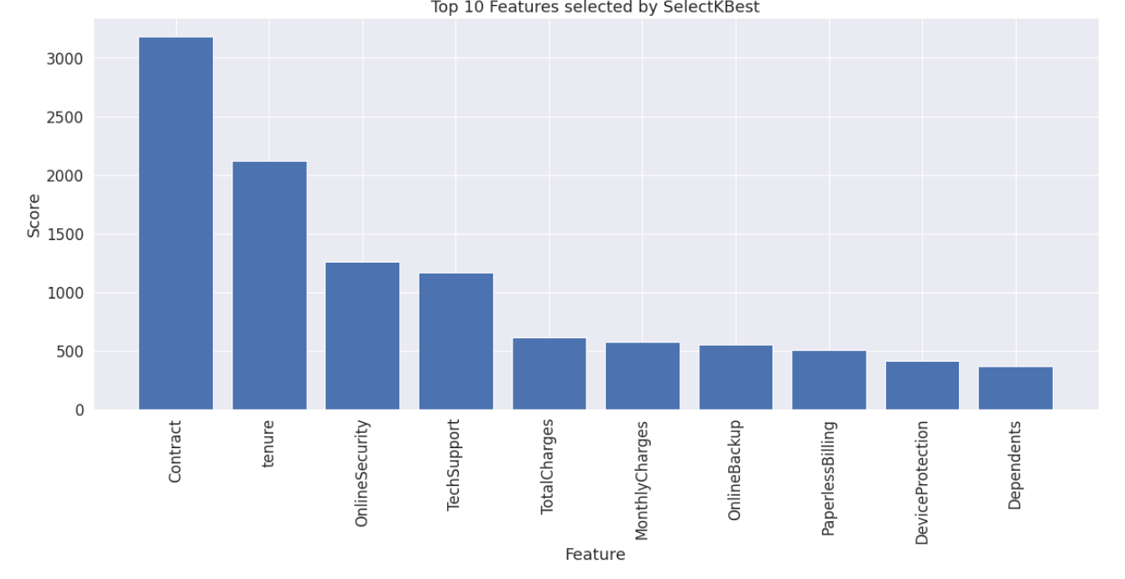
Top ten most important features in the data Used in Model 1 and 2

Slide 16
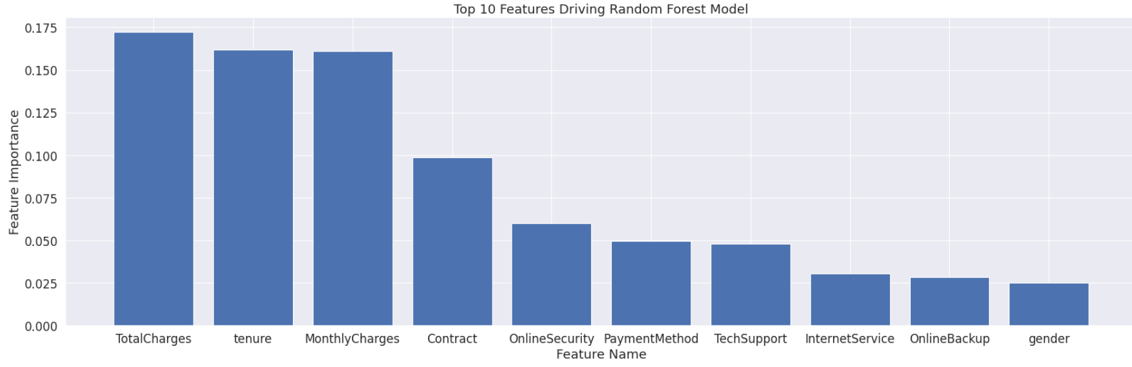
Top ten features driving the model 3

Slide 17

Findings

Slide 18
Findings...
Analysis from drivers of these three models and others reveal
that some features are considerably important in customer
churn rate. These factors offers opportunities to customer
retention.

Slide 19
Features to consider to reduce customer churn rate
Contract
Monthly charges
Total charges
Tenure
Online security
Tech support

Slide 20
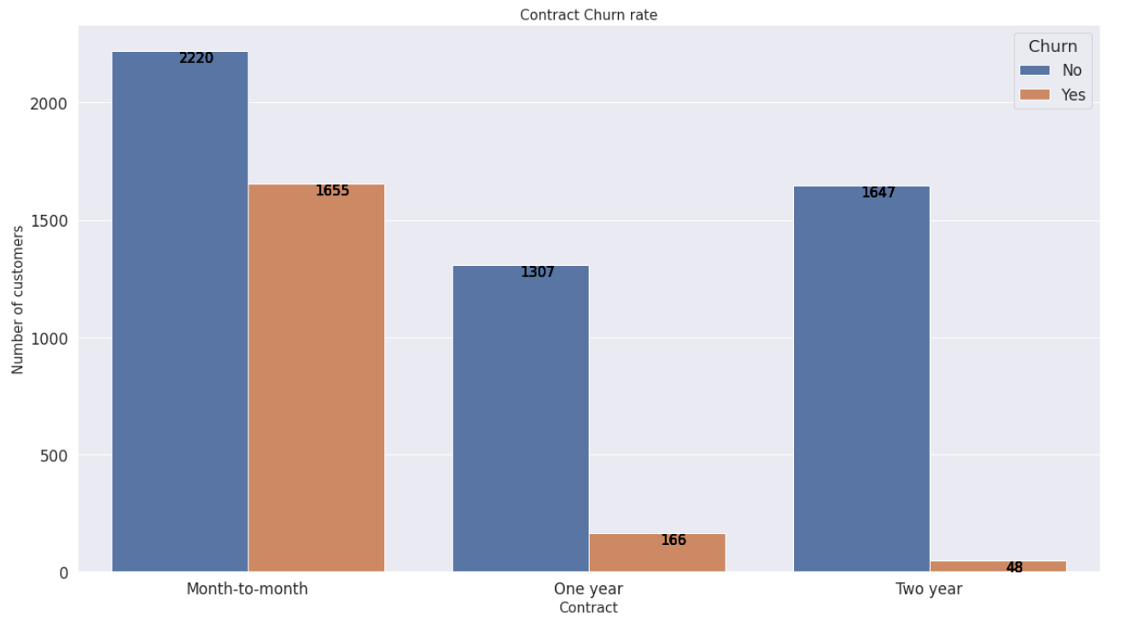
Relationship between contract and churn rate
.

Slide 21
Relationship between contract and churn rate
Customers on two years contract had the lowest churn rate of 2% compared to month-to- month contract with a churn rate of 42%

Slide 22
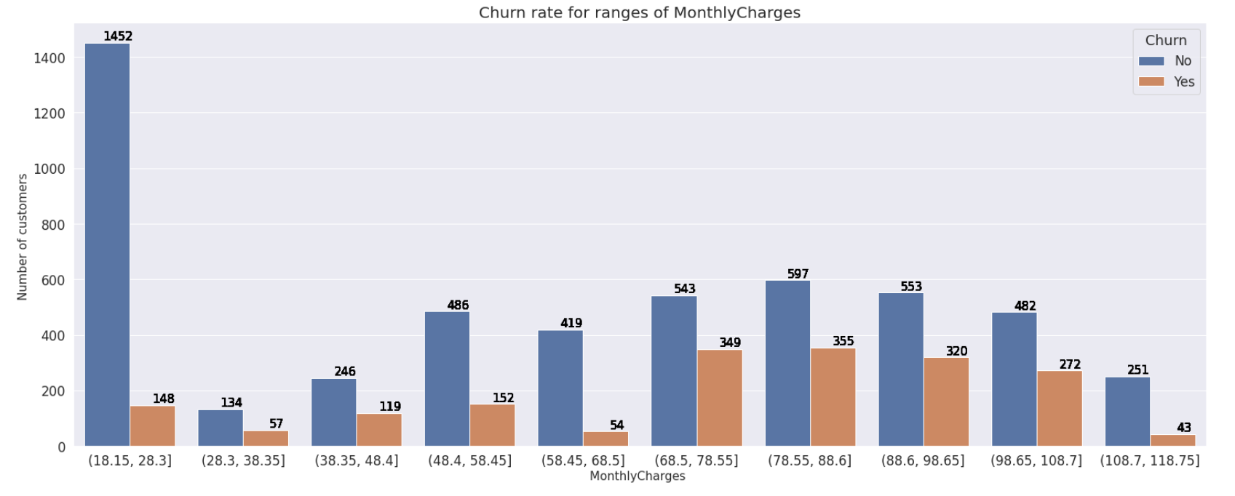
Relationship between monthly charges and churn rate

Slide 23
Relationship between monthly charges and churn rate
The highest churn rate recorded (39%) due to monthly charges is between 68.5 to 78.55

Slide 24
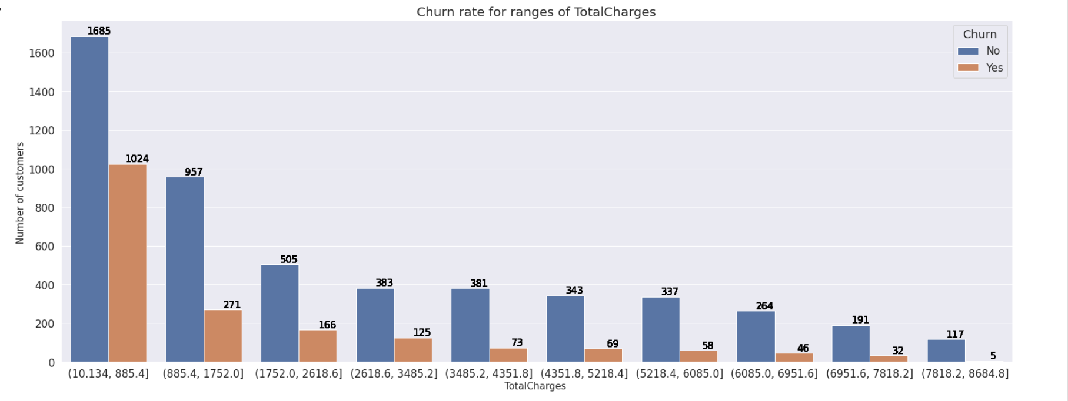
Relationship between total charges and churn rate

Slide 25
Relationship between total charges and churn rate
Relationship between total charges and churn rate indicates that the highest churn rate was experienced when total charges was between 10.134 and 885.4

Slide 26
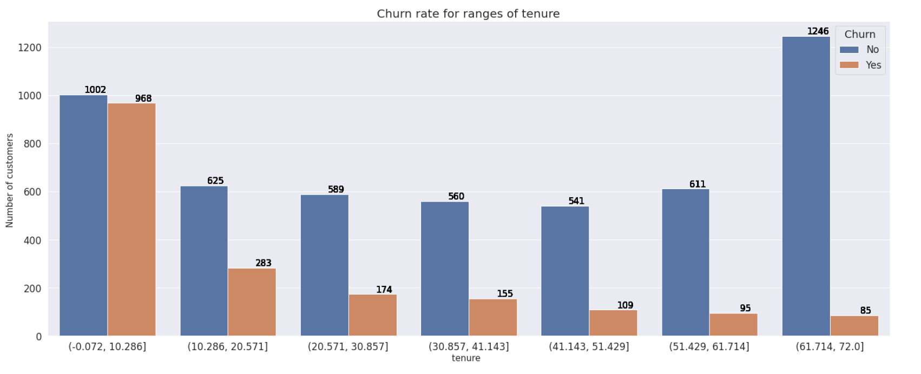
Relationship between tenure and churn rate

Slide 27
Relationship between tenure and churn rate
Highest churn rate was experienced when customers were about 10 months or less. This aligns with the highest churn rate of customers on month–to- month contract

Slide 28
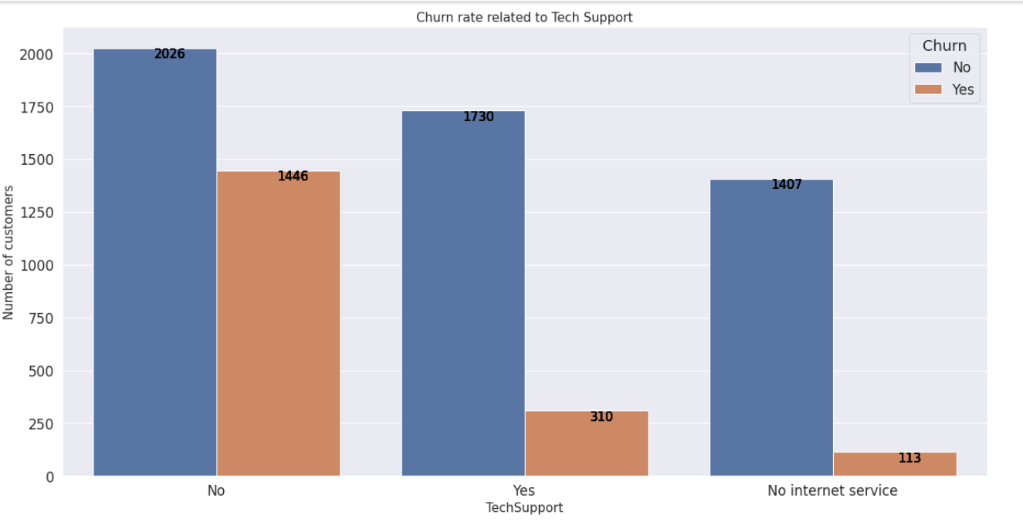
Relationship between tech support and churn rate

Slide 29
Relationship between tech support and churn rate
Customers without tech support show a higher rate of leaving

Slide 30
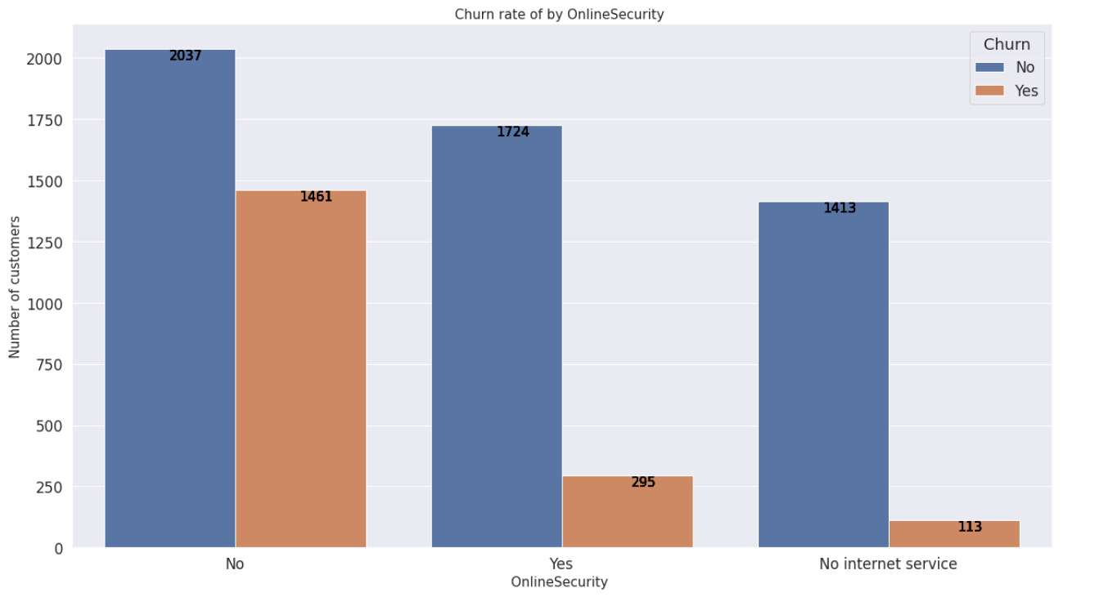
Relationship between online security and churn rate

Slide 31

Relationship between online security and churn rate
Customers without online security likelihood of leaving is more compared to others in this category. The rate is 42%

Slide 32

Recommendations
Drive more sales on two years contract. Incentives, discount can be used to encourage customers.
Month-to-month contract customers have the highest churn rate.IT suggests that customers decided to leave within a short period. Quality of service they receive should be considered. The average time it takes a customer to get help when needed is important.

Slide 33
Recommendations
Engage customers more during the early stage of their contract especially short -term contract customers like month-to-month to get feedback on the quality of service they are receiving. Customes who are contemplating leaving would likely register their disdain

Slide 34
Appendix

Slide 35
Comparisons of top three models
Model / metric measurements | Radom Forest Tree (%) (Model 1) | Gradient Boosted Decision Tree (%) (Model 2) | Random Forest (%) (Model 3)
Accuracy | 89 | 89 | 88
Precision 1 (Fully paid) | 85 | 85 | 84
Precision 0 (charged -off) | 94 | 93 | 98
Recall 1 (Fully paid) | 95 | 94 | 94
Recall 0 (charged -off) | 83 | 84 | 82
F1- score 1 (Fully paid) | 89 | 89 | 88
F1- score 0 (charged -off) | 88 | 88 | 87

Slide 36
Confusion matrix of top three models
Models | TP | TN | FP | FN
Random Forest (Model 1) | 1470 | 1280 | 263 | 85
Gradient Boosted Decision Tree (Model 2) | 1459 | 1294 | 249 | 96
Random Forest (Model 3) | 1456 | 1258 | 284 | 100

Slide 37
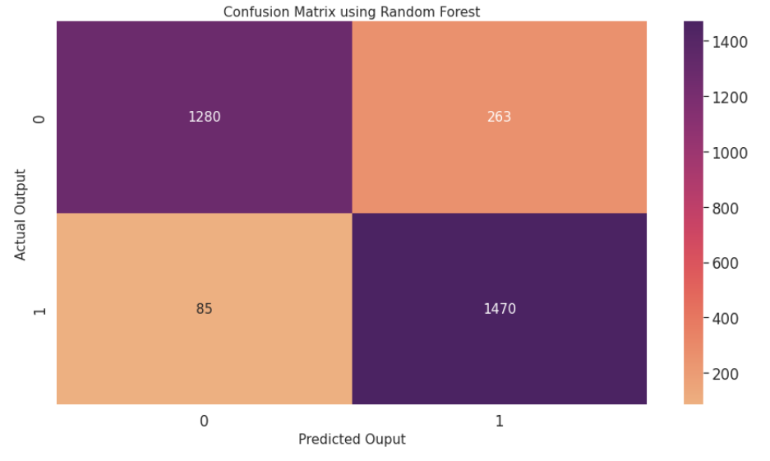
Confusion matrix for model 1

Slide 38
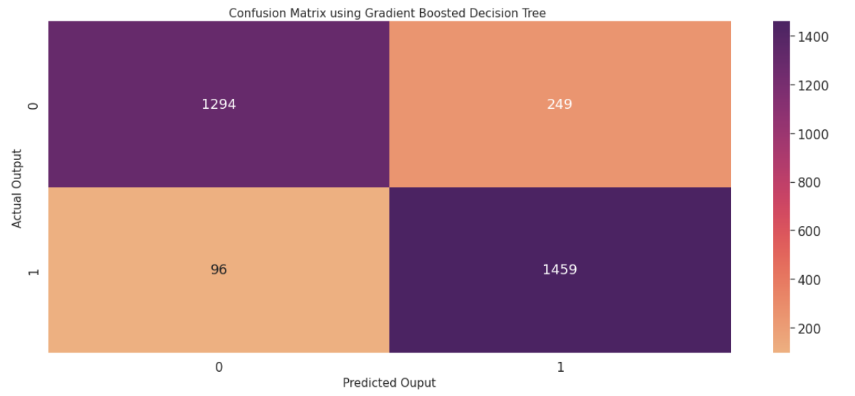
Confusion matrix for model 2

Slide 39
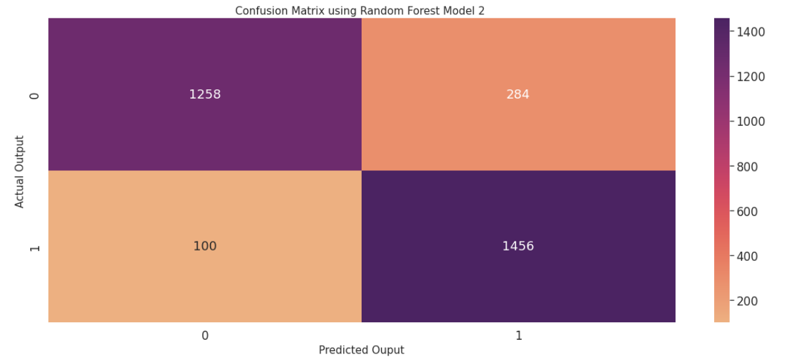
Confusion matrix for Model 3

